Slide 1

Spark for data Engineers
SQLBits 2022, March 8th, 2022
Tomaž Kaštrun

Slide 2
Agenda
6 modules; 50min +/- 10min work
Start: 10AM CET/9AM GMT – 5PM CET/4PM GMT
2x coffee break, 1x lunch break
Ask anytime, discussion welcome
Mute your mic if you are not asking

Slide 3
Material
Material available on Github; clone the repository
Downloadable programs (spark, JVM, Hadoop) from internet
Azure subscription
Coffee and good energy ☺
Github: https://github.com/tomaztk/workshop-spark-data-engineers

Slide 4


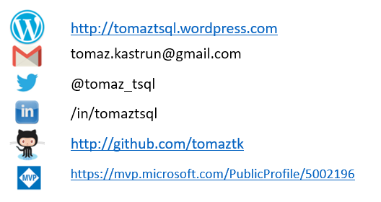
With you today
BI Developer | data analyst | data scientist
SQL Server, SAS, R, Python, C#, SAP, SPSS
20years experience MSSQL, DEV, BI, DM
Frequent community speaker
Avid coffee drinker & bicycle junkie

Slide 5
Help today

Slide 6
Module 1
General overview, Apache Spark, Environment setting

Slide 7
Module 1
About Apache Spark
Spark execution modes
Installation
Running Spark

Slide 8
On Apache Spark
Fast, expressive, general-purpose in-memory cluster computing framework compatible with Apache Hadoop and built around speed, ease of use and streaming analytics Faster and easier than Hadoop MapReduce* Large community and 3rd party libraries
Provides high-level APIs (Java, Scala, Python, R) Supports variety of workloads
interactive queries, streaming, machine learning and graph processing

Slide 9
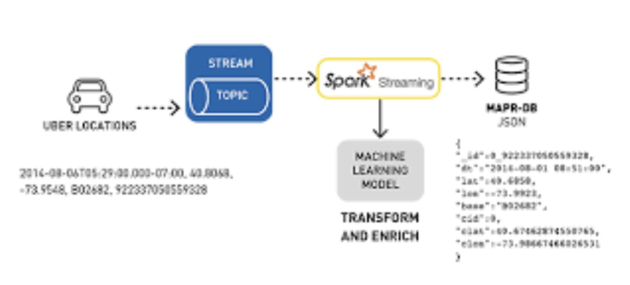
Spark Use-Cases
Logs processing (Uber)
Event detection and real-time analysis
Interactive analysis
Latency reduction
Advanced ad-targeting (Yahoo!)
Recommendation systems (Netflix, Pinterest)
Fraud detection
Sentiment analysis (Twitter)

Slide 10
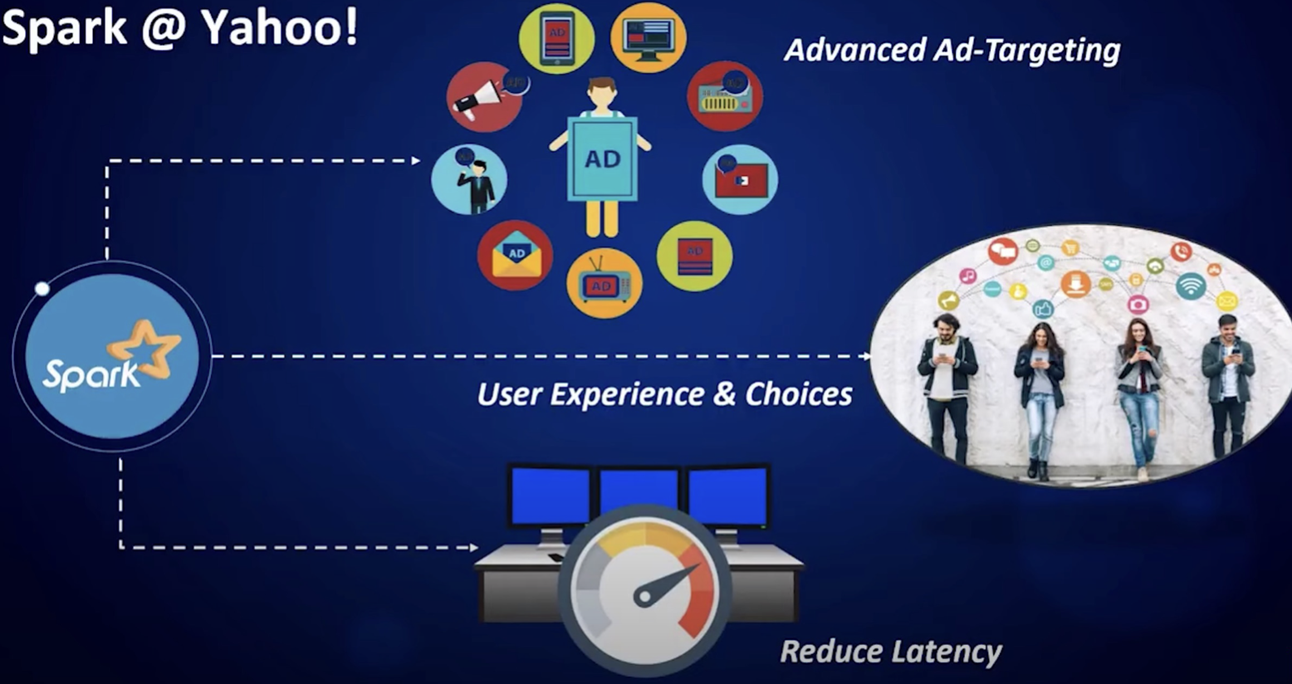
Spark Use-Cases
Logs processing (Uber)
Event detection and real-time analysis
Advanced ad-targeting (Yahoo!)

Slide 11
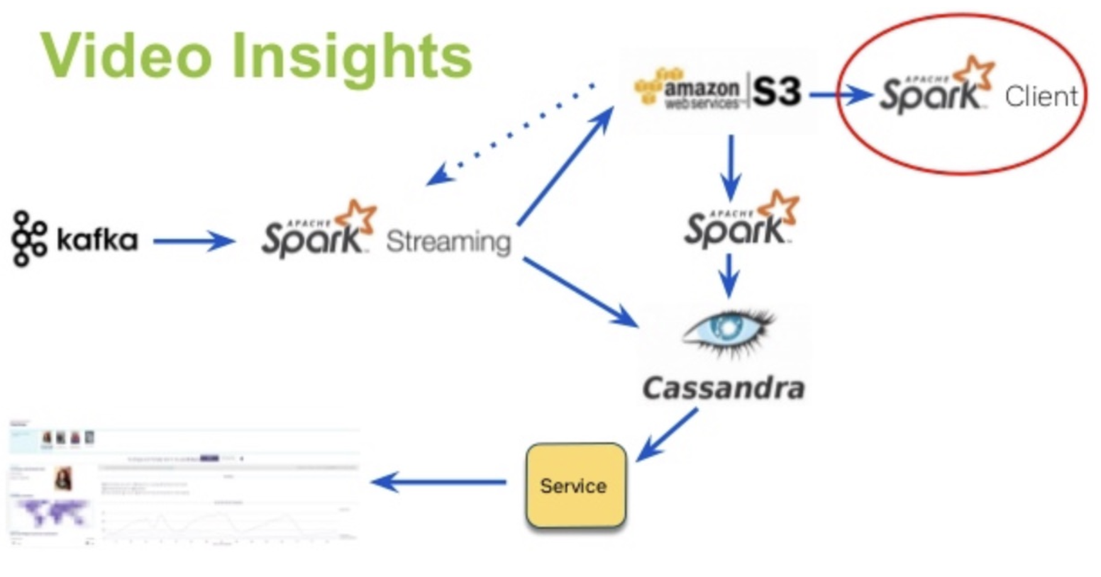
Spark Use-Cases
Logs processing (Uber)
Event detection and real-time analysis
Interactive analysis
Latency reduction
Advanced ad-targeting (Yahoo!)
Recommendation systems (Netflix, Pinterest)
Fraud detection
Sentiment analysis (Twitter)

Slide 12
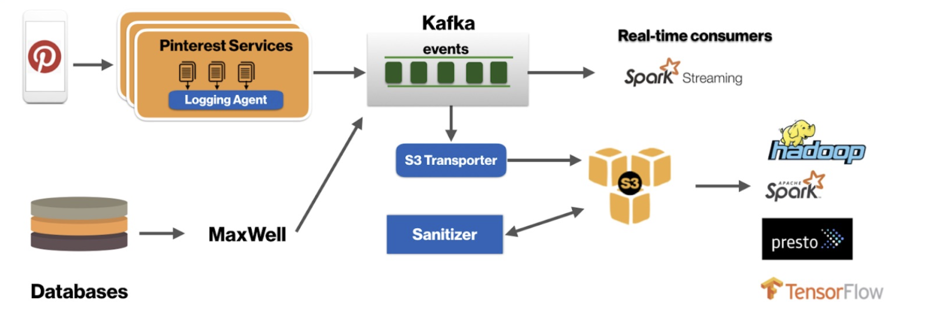
Spark Use-Cases
Recommendation systems (Netflix, Pinterest)
Fraud detection
Sentiment analysis (Twitter)

Slide 13
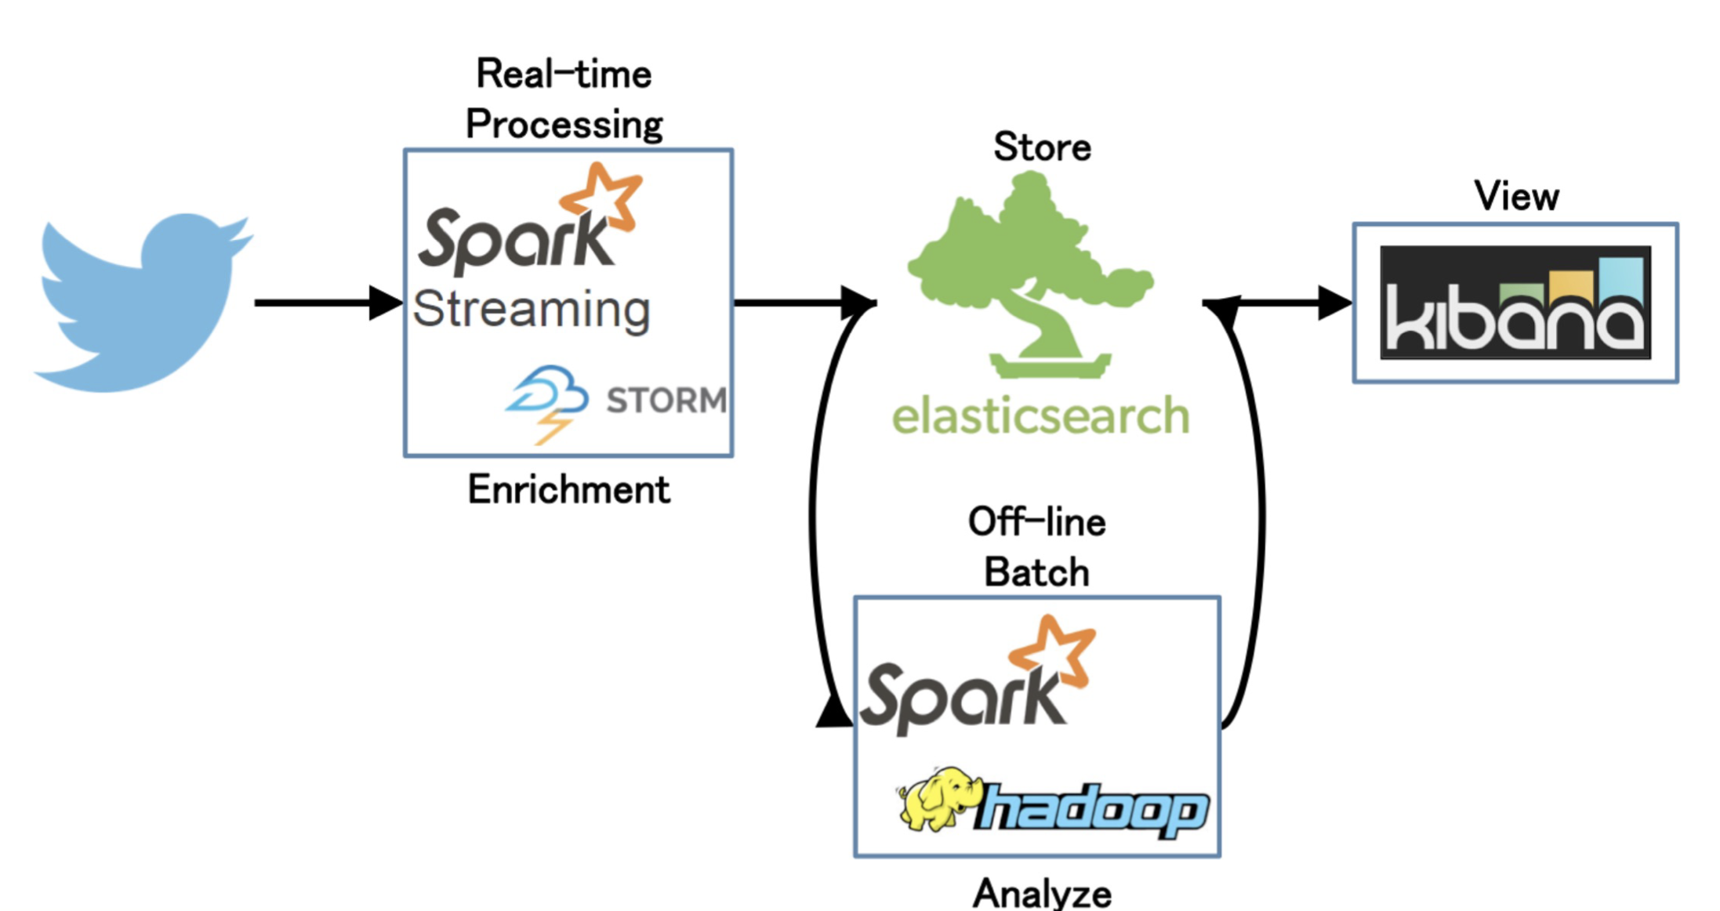
Spark Use-Cases
Sentiment analysis (Twitter)

Slide 14
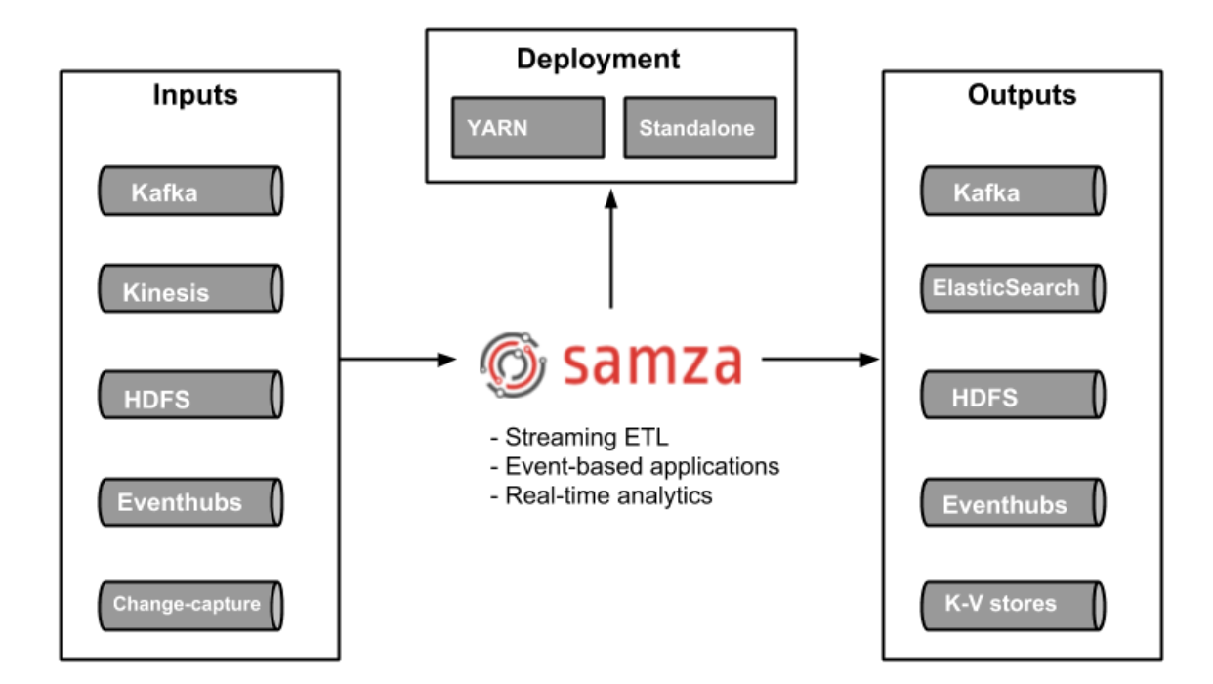
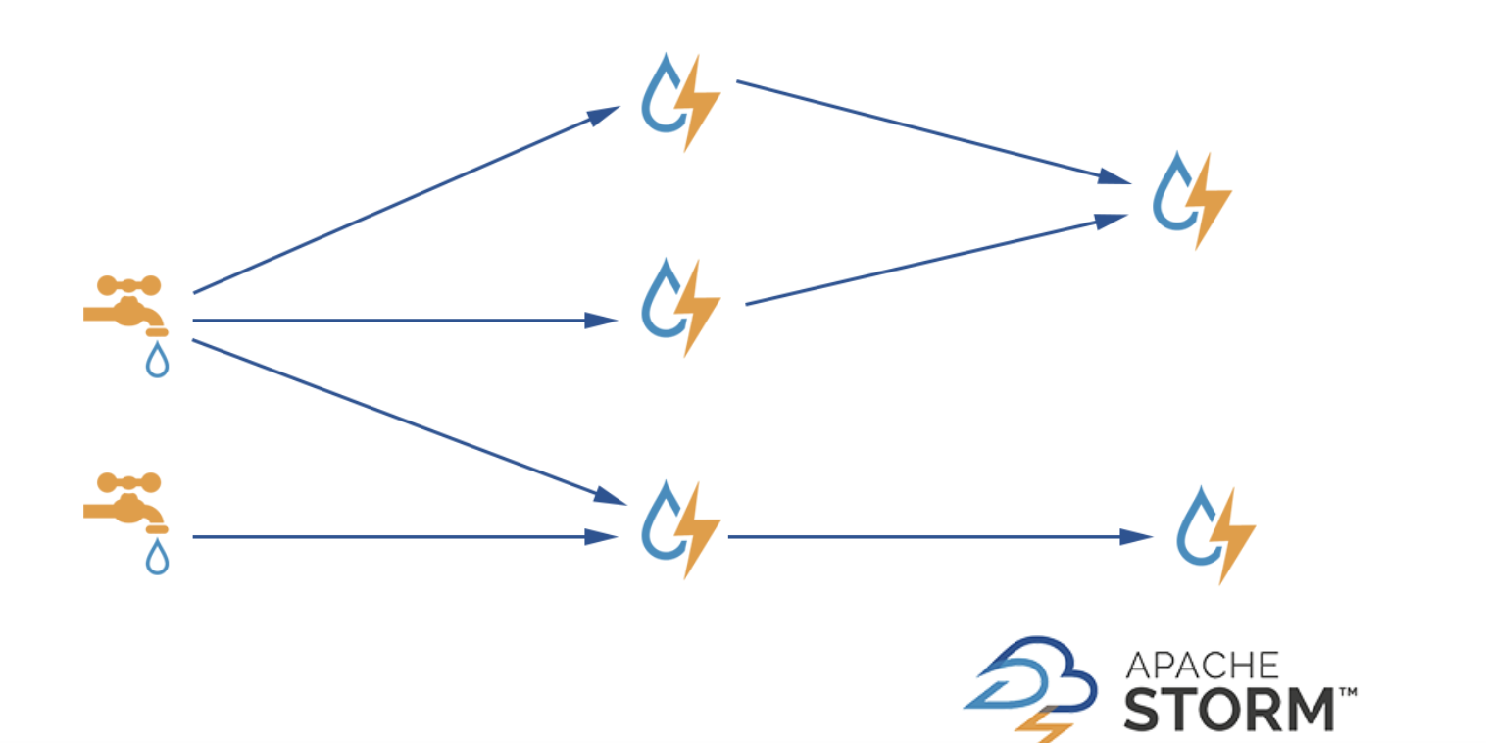
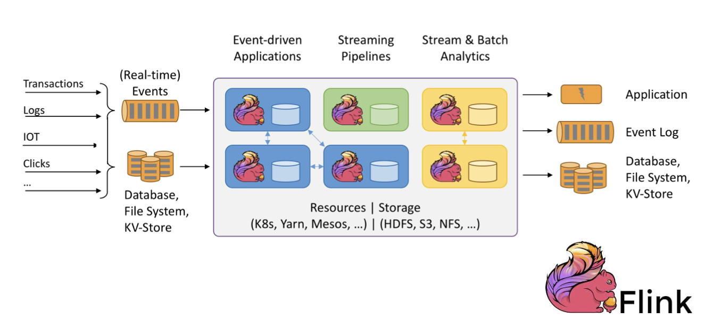
Apache Spark “real-time”
Apache Samza (library/framework)
Apache Storm (real-time stream processing)
Apache Flink (native streaming support for all workloads)

Slide 15
Apache Spark 3.x
Latest release – v3.2.1. (Jan 26, 2022)
Improvements over Spark 2 (v2.4.1)
Python 2 deprecated
Adaptive execution of Spark SQL (merging intermediate results among workers)
Dynamic partition pruning
Support for deep learning (GPU support for Nvidia, AMD, Intel)
Better Kubernetes integration
Graph features (Morpheus as extension of Cypher, neo4j support)
ACID transactions (for Delta Lake storage)
Apache Arrow data format integration (columnar format for analytics)

Slide 16
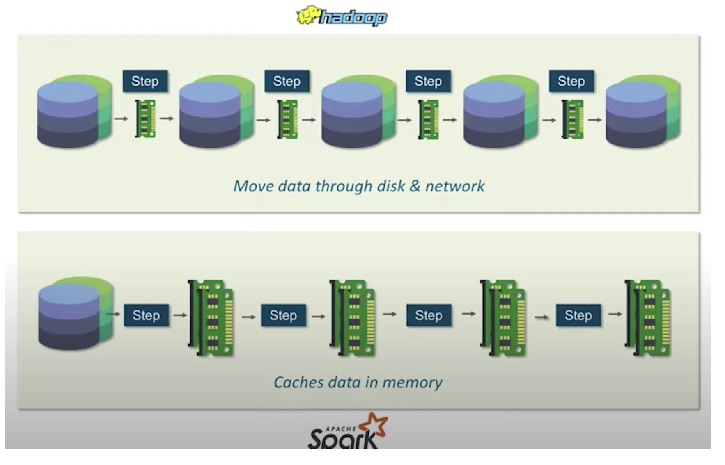
Hadoop MapReduce vs. Apache Spark
Big data frameworks
Performance
Ease of use
Costs
Data processing
Fault tolerance
Security
Hadoop
Archival data analysis
Spark
Real-time data analysis

Slide 17
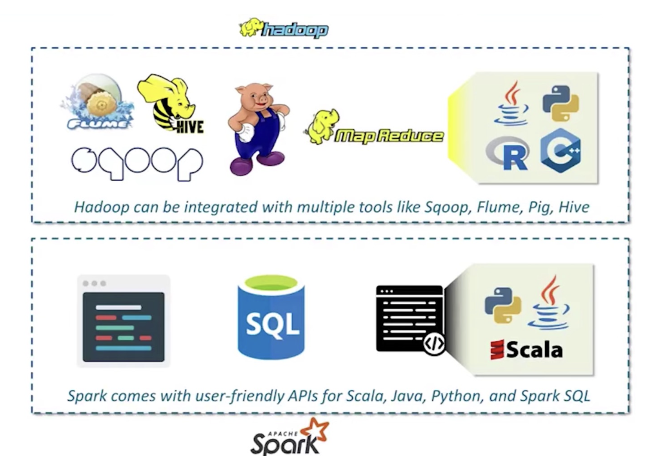
Hadoop MapReduce vs. Apache Spark

Slide 18
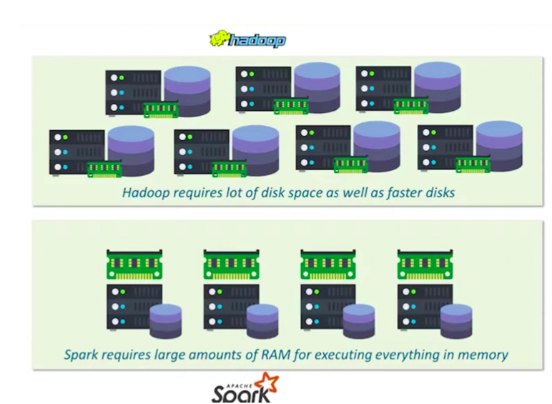
Hadoop MapReduce vs. Apache Spark

Slide 19
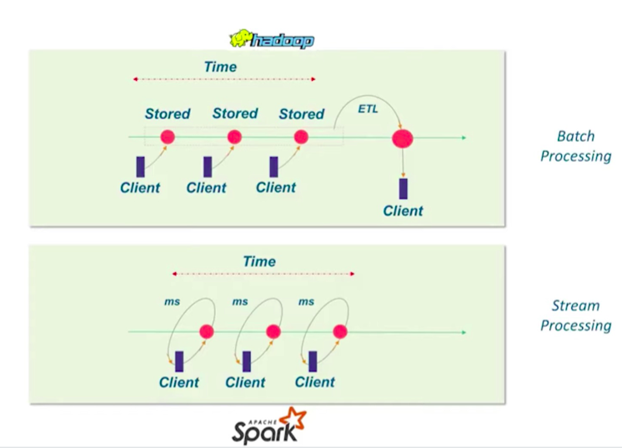
Hadoop MapReduce vs. Apache Spark

Slide 20
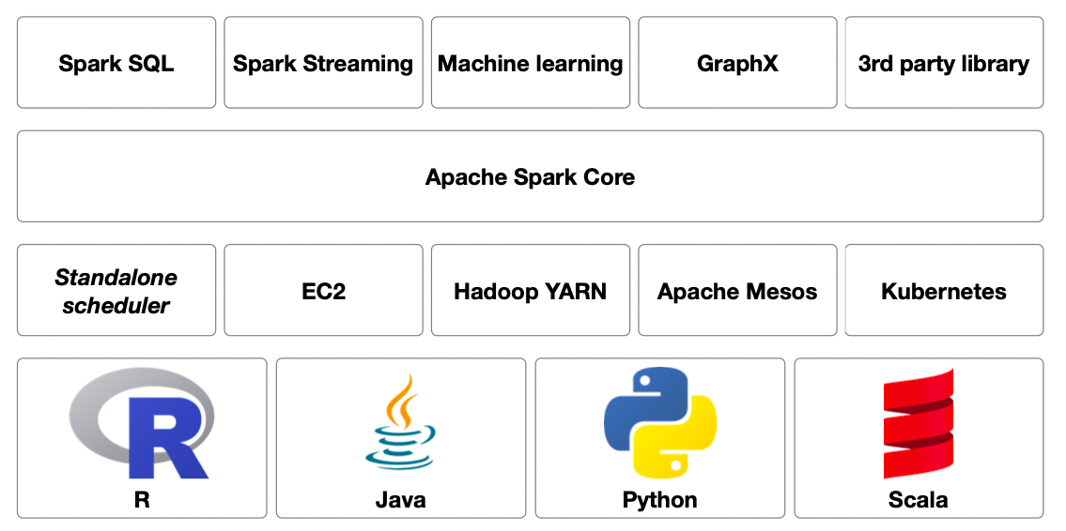
Apache Eco-System

Slide 21
Spark Core functionalities
Core functionalities
task scheduling
memory management
fault recovery
storage systems interaction
etc.
Basic data structure definitions/abstractions
Resilient Distributed Data sets (RDDs)
main Spark data structure
Directed Acyclic Graph (DAG)

Slide 22
Ecosystem: Spark SQL
Structured data manipulation
Data Frames definition
Table-like data representation
RDDs extension
Schema definition
SQL queries execution Native support for schema-based data
Hive, Paquet, JSON, CSV

Slide 23
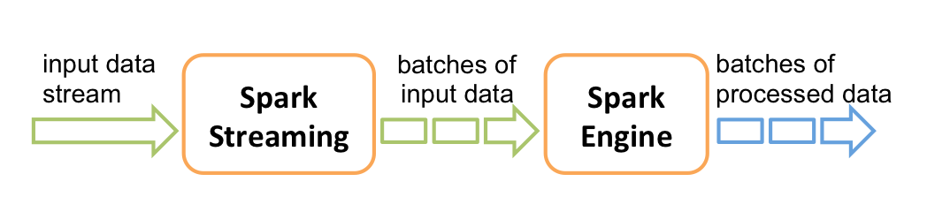
Ecosystem: Spark Streaming
Data analysis of streaming data
e.g. tweets, log messages, SCADA
Features of stream processing
High-throughput
Fault-tolerant
End-to-end
Exactly once
High-level abstraction of a discretized stream
Stream represented as a sequence of RDD
With Spark 2.3.x and above continuous processing
End-to-end low latency (< 1ms)

Slide 24
Ecosystem: Spark MLlib for Machine Learning
Common ML functionalities
ML Algorithms
common learning algorithms such as classification, regression, clustering, and collaborative filtering
Featurization
feature extraction, transformation, dimensionality reduction, and selection
Pipelines
tools for constructing, evaluating, and tuning ML Pipelines
Persistence
saving and load algorithms, models, and Pipelines
Utilities
linear algebra, statistics, data handling, etc.
Two APIs
RDD-based API (spark.mllib package)
Spark 2.0+, DataFrame-based API (spark.ml package)
Methods scale out across the cluster by default

Slide 25
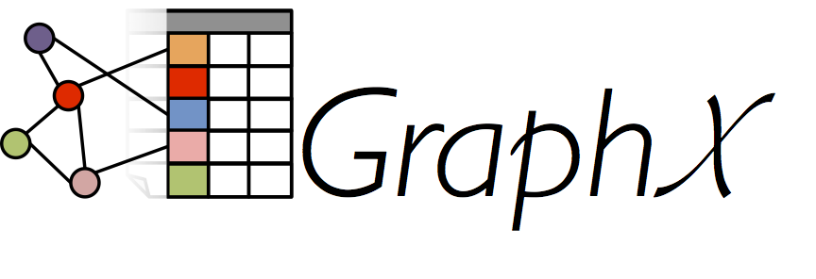
Ecosystem: GraphX
Support for graphs and graph-parallel computation
Extension of RDDs (Graph)
Direct multigraph with properties on vertices and edges
Graph computation operators
subgraph, joinVertices, and aggregateMessages, etc.
Pregel API support

Slide 26
Spark Modes
Spark operates in 4 different modes:
Standalone Mode: Here all processes run within the same JVM process.
Standalone Cluster Mode: In this mode, it uses the Job-Scheduling framework in-built in Spark.
Apache Mesos: In this mode, the work nodes run on various machines, but the driver runs only in the master node.
Hadoop YARN: In this mode, the drivers run inside the application’s master node and is handled by YARN on the Cluster.

Slide 27
Spark Context
driver Spark application which communicates the user commands to the Spark Workers
`SparkContext` is an object, which coordinates with the cluster manager about the resources required for execution and the actual tasks that need to be executed
Submitting spark applications: Submitting Applications - Spark 3.2.1 Documentation (apache.org)

Slide 28
Execution modes
Local mode
„Pseudo-cluster“ ad-hoc setup using script
Cluster mode
Running via cluster manager
Interactive mode
Direct manipulation in a shell (pyspark, spark-shell)

Slide 29
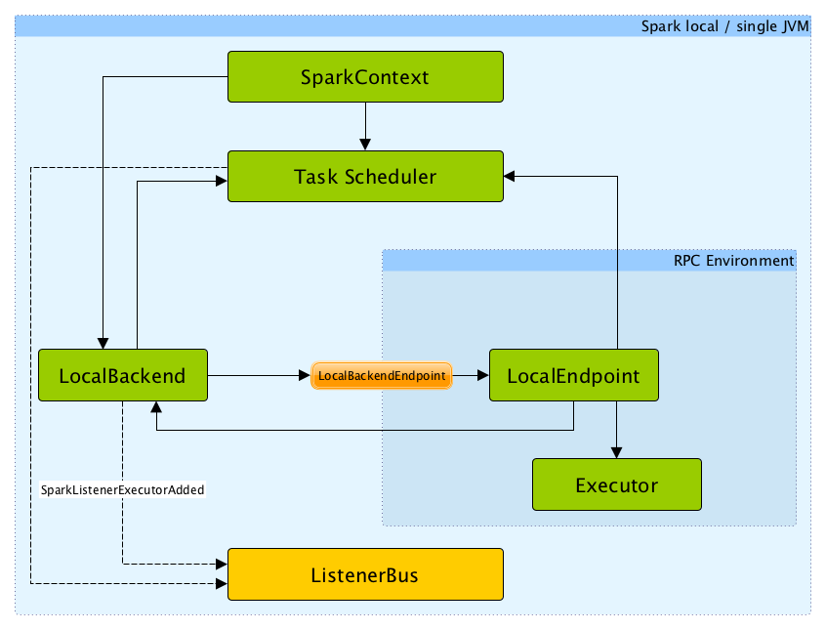
Spark execution modes Local mode
Non-distributed single-JVM deployment mode
Spark library spawns (in a JVM)
driver
scheduler
master
executor
Parallelism is the number of threads defined by a parameter N in a spark master URL
local[N]

Slide 30
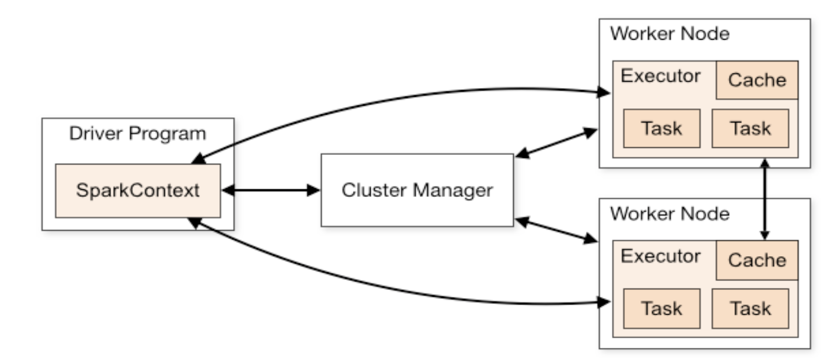
Spark execution modes Cluster mode
Deployment on a private cluster
Apache Mesos
Hadoop YARN
Kubernetes
Standalone mode, ...

Slide 31
Spark execution modes Cluster mode
Components
Worker
Node in a cluster, managed by an executor
Executor manages computation, storage and caching
Cluster manager
Allocates resources via SparkContext with Driver program
Driver program
A program holding SparkContext and main code to execute in Spark
Sends application code to executors to execute
Listens to incoming connections from executors

Slide 32
Spark execution modes Cluster mode
Deploy modes (standalone clusters)
Client mode (default)
Driver runs in the same process as client that submits the app
Cluster mode
Driver launched from a worker process
Client process exits immediately after application submission

Slide 33
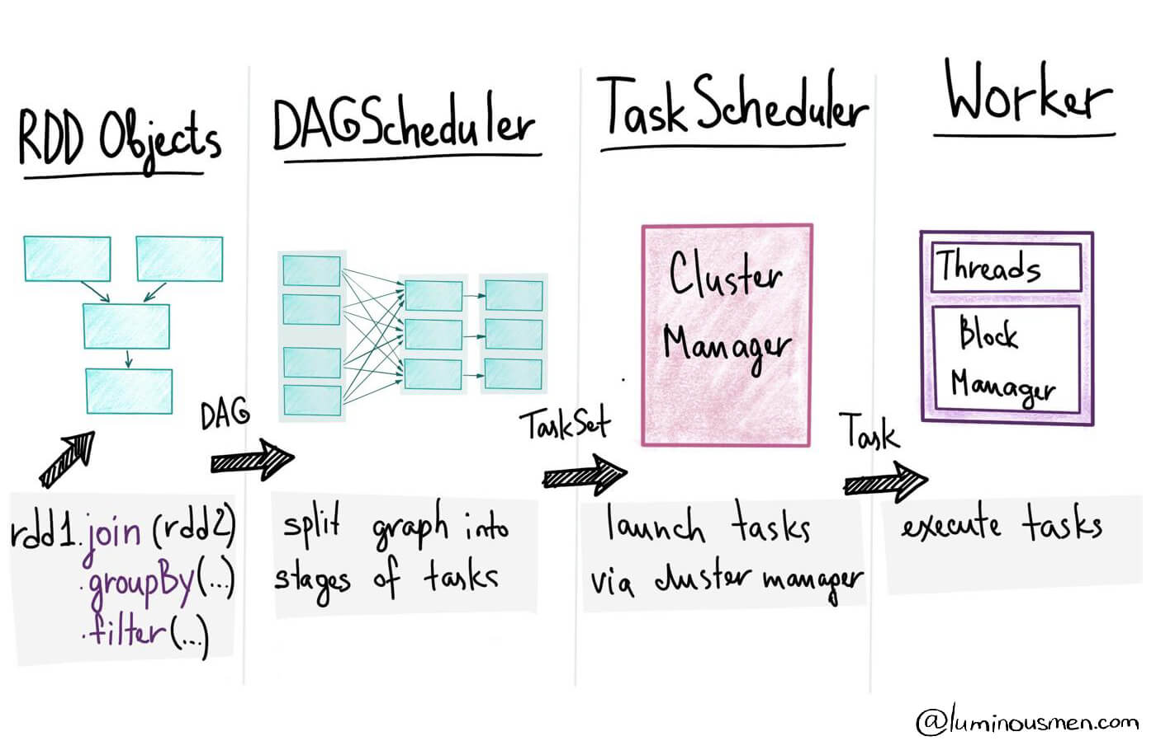
Spark execution process
Data preparation/import
RDDs creation – i.e. parallel dataset with partitions
Transformations/actions definition*
Creation of tasks (units of work) sent to one executor
Job is a set of tasks executed by an action*
Creation of a directed acyclic graph (DAG)
Contains a graph of RDD operations
Defition of stages – set of tasks to be executed in parallel (i.e. at a partition level)
Execution of a program (application)

Slide 34
Shell vs.Cluster mode
Shell Is interactive
Cluster is for connecting into private network with several machines
In cluster mode, it’s called submitting applications

Slide 35
Submitting applications
Pseudo code
./bin/spark-submit \
--class <main-class> \
--master <master-url> \
--deploy-mode <deploy-mode> \
--conf <key>=<value> \
... # other options <application-jar> \
[application-arguments]

Slide 36
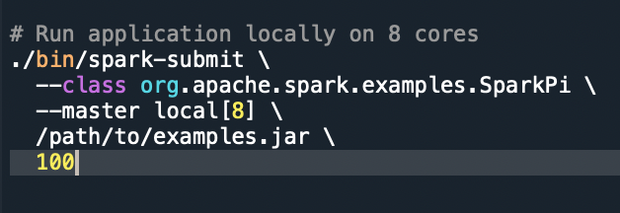
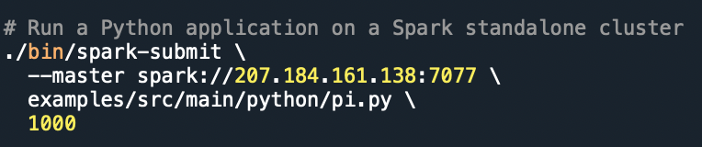
Applications: Locally, in Standalone cluster

Slide 37
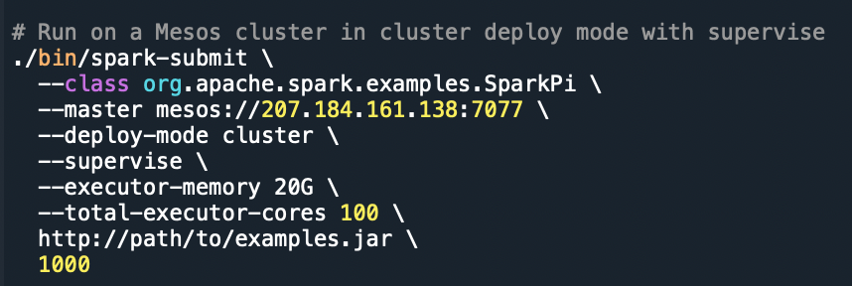
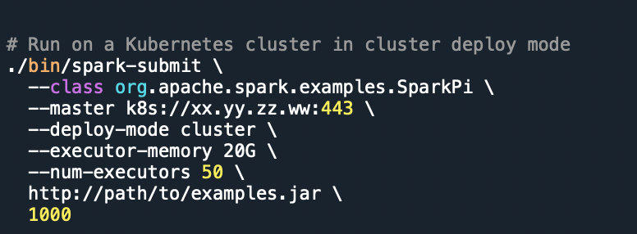
Applications: Mesos and Kubernetes

Slide 38
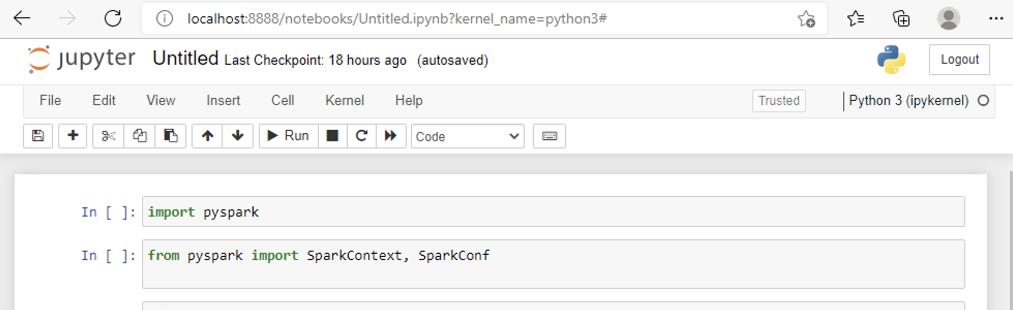
Module 1 – Task 1
Explore Spark
Run Jupyter Notebook locally
Connect to Azure
Check: Advent of 2021, Day 3 – Getting around CLI and WEB UI in Apache Spark | TomazTsql (wordpress.com)

Slide 39
Module 2

Slide 40
Module 2
Basic Spark data structures (RDDs)
RDDs and operations
RDD transformation and RDD actions
Creating DataFrames
Creating DataSets
Working with Spark API
Spark DataFrame API
Structured API (SQL)

Slide 41
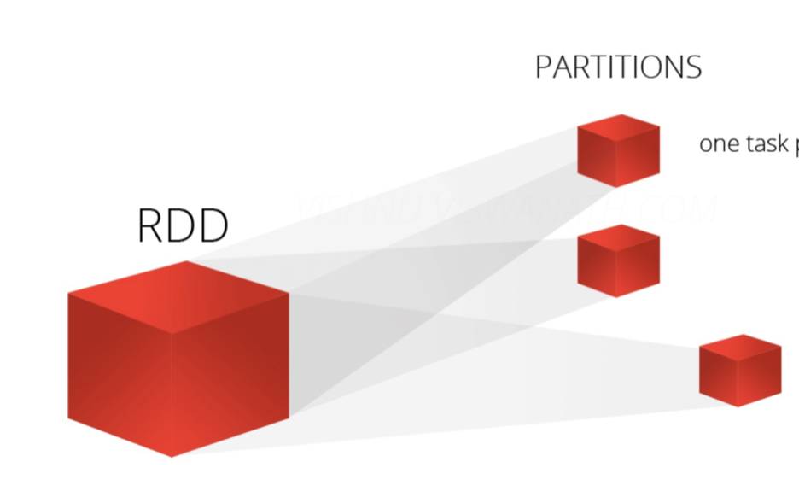
Spark Programming concepts - RDD
RDD – Resilient distributed datases
Basic data representation in Spark
A distributed collection of items – partitions
Enables parallel operations
RDDs are immutable (”read-only“)
Fault-tolerant
Achieving 100% data preseration, every function creates new partition
Caching and different storage levels possible
Supports a set of Spark transformation and actions

Slide 42
Spark Programming concepts - RDD
Computations are expressed using
Creation of new RDDs
Transforming existing RDDs
Operations on RDDs to compute results (actions!)
Distributes the data within RDDs across nodes
(executors) in the clust and parallelizes the
calculations

Slide 43
RDD operations
RDDs enable following operations
transformations
lazy operations that return a new RDD from input RDDs
narrow or wide types
examples: map, filter, join, groupByKey...
actions
return a result or write to storage, execute transformations
examples: count, collect, save

Slide 44
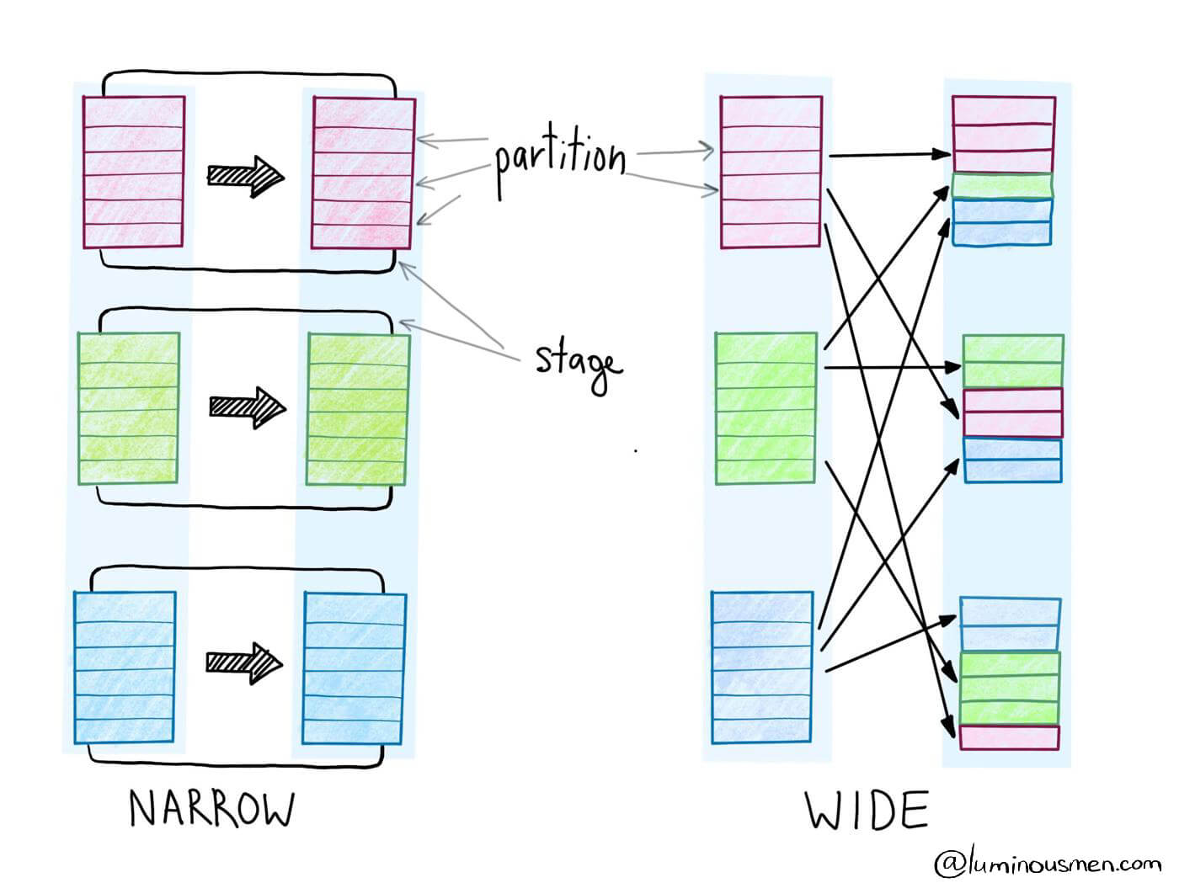
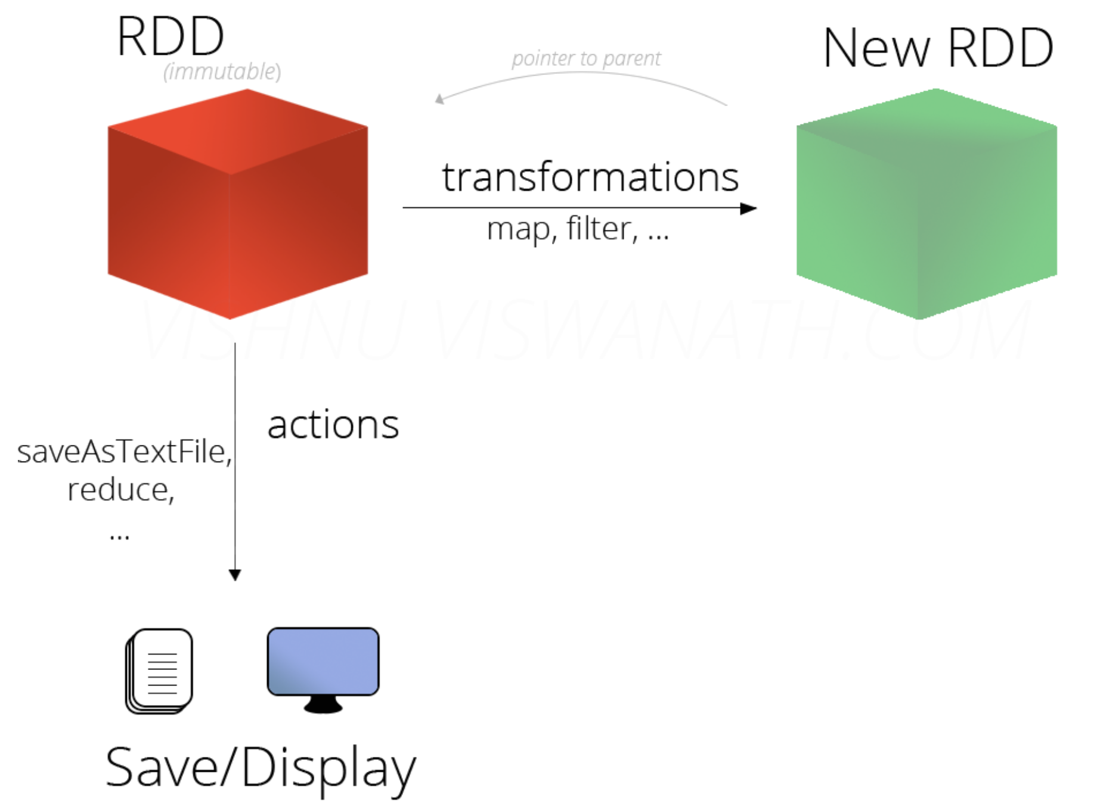
RDD: Transformation and actions

Slide 45
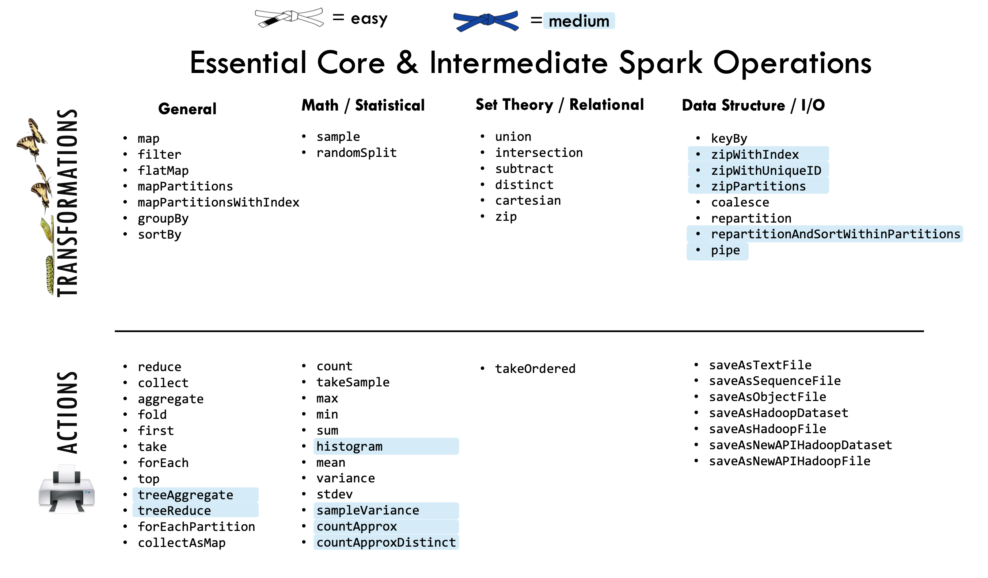
RDD Transformation vs. Actions
Source: URL

Slide 46
RDD in Spark
Continue with notebooks
Explore Spark Web UI

Slide 47
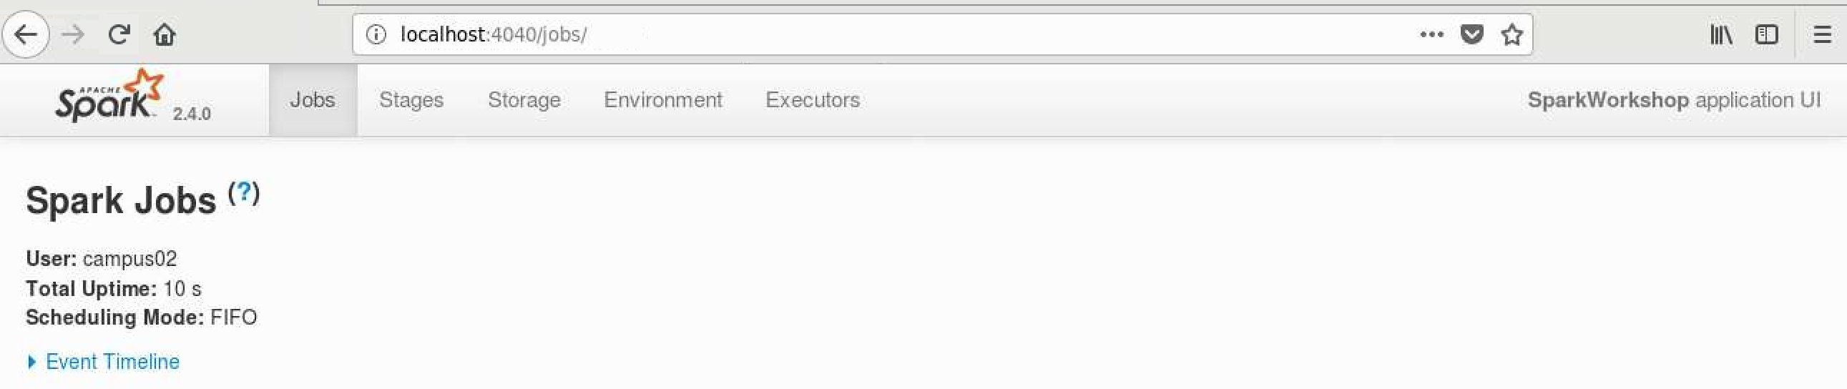
RDD in Spark and explore Web UI
We will use pySpark library interactively
import pyspark
sc = pyspark.SparkContext(appName=‚‘SparkWorkshopSQLBits', master='local[1]')

Slide 48
RDD in Spark and explore Web UI
Creation of RDDs
From a collection
rdd1 = sc.parallelize([('John', 23), ('Mark', 11), ('Jenna', 44), ('Sandra', 61)])
From a file
rdd2 = sc.textFile('data/IMDB Dataset.csv‘)
Basic transformations map(), filter(), flatMap()
older = rdd1.filter(lambda x: x[1] > 18)
anonymized = older.map(lambda x: (x[0][0], x[1]))
birthdays = rdd1.map(lambda x: list(range(1, x[1]+1)))
birthdays = rdd1.flatMap(lambda x: list(range(1, x[1]+1)))
birthdays.map(lambda x: (x, 1)).groupByKey() \
.mapValues(lambda vals: len(list(vals))).sortByKey()

Slide 49
RDD in Spark and explore Web UI
Further actions, transformations
rdd2.take(2)
def organize(line):
data = line.split('",')
data = data if len(data) == 2 else line.split(',')
return (data[1], data[0][1:51] + ' ...')
movies = rdd2.filter(lambda x: x != 'review,sentiment').map(organize)
movies.count() // 50.000
movies = movies.filter(lambda x: x[0] in ['positive', 'negative'])
movies.count() // 45.936
movieCounts = movies.groupByKey().map(lambda x: (x[0], len(x[1])))

Slide 50
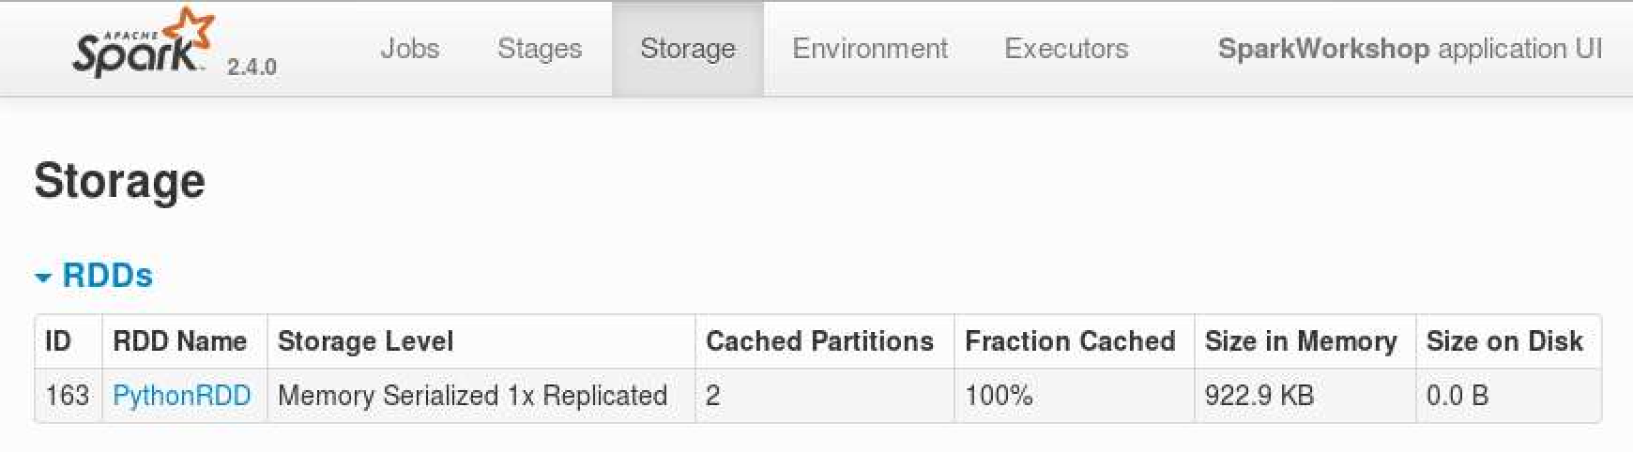
RDD in Spark and explore Web UI
Caching
movies.take(2)
posReviews = movies.filter(lambda x: x[0] == 'positive').map(lambda x: x[1])
negReviews = movies.filter(lambda x: x[0] == 'negative').map(lambda x: x[1])
posReviews.cache().collect()

Slide 51
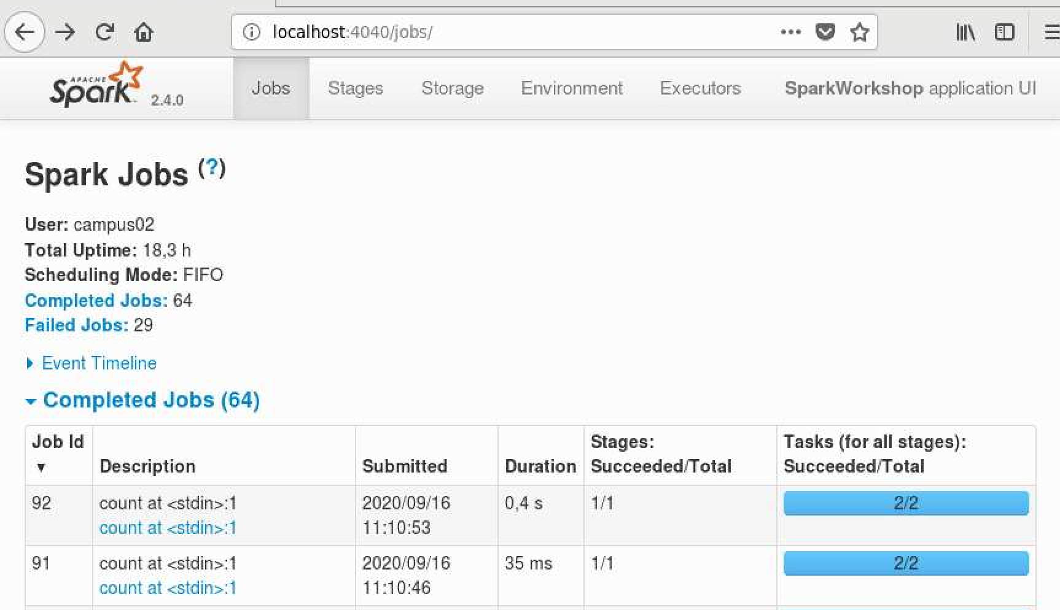
RDD in Spark and explore Web UI
Caching
posReviews.filter(lambda x: 'good' in x).count() //605
negReviews.filter(lambda x: 'bad' in x).count() //788

Slide 52
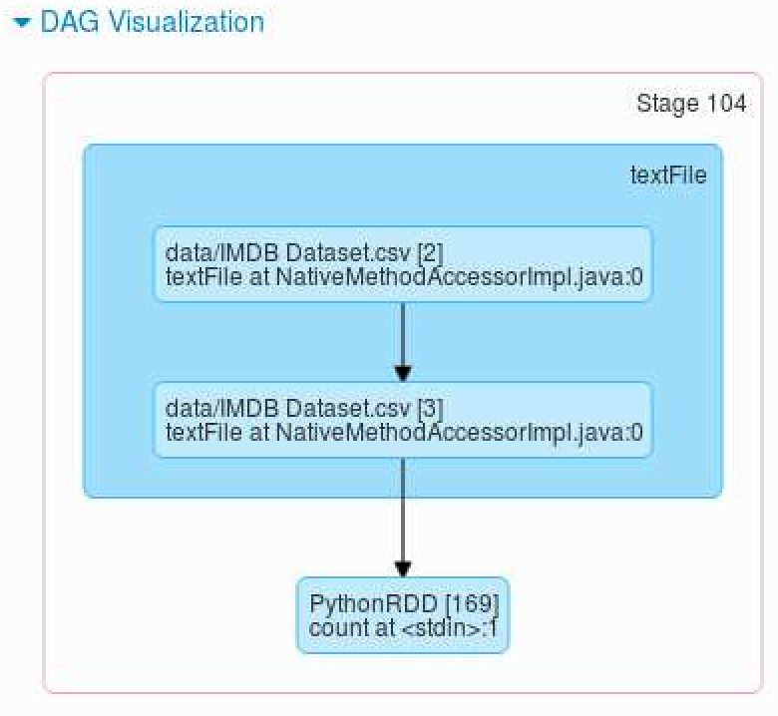
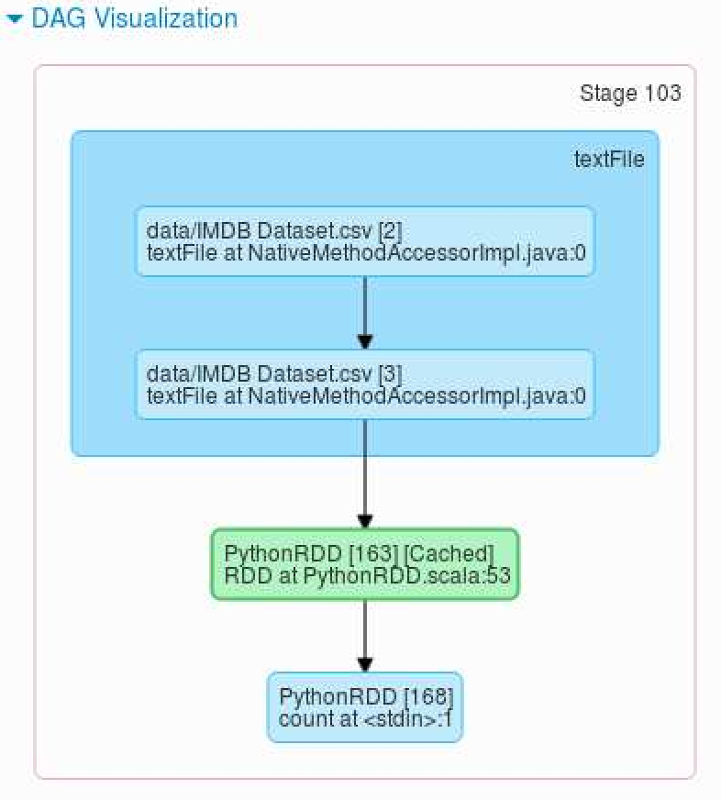
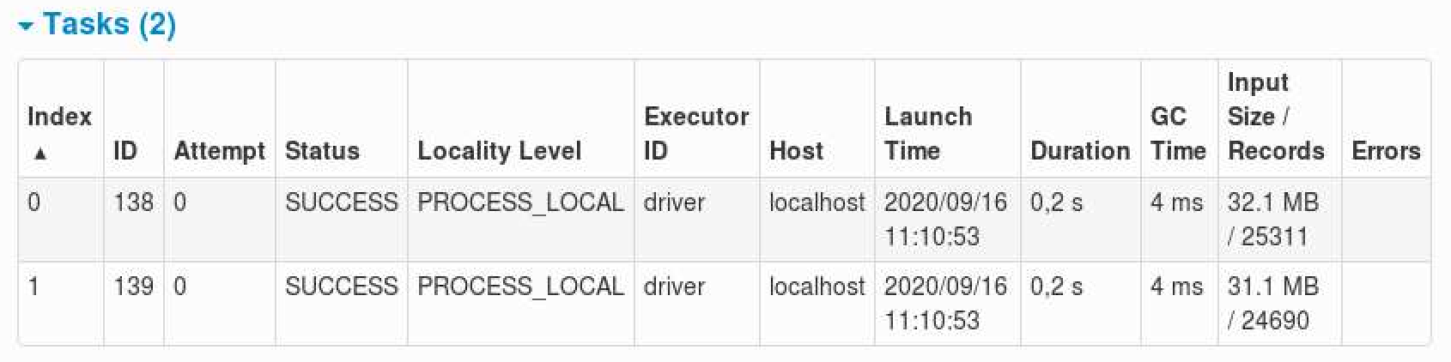
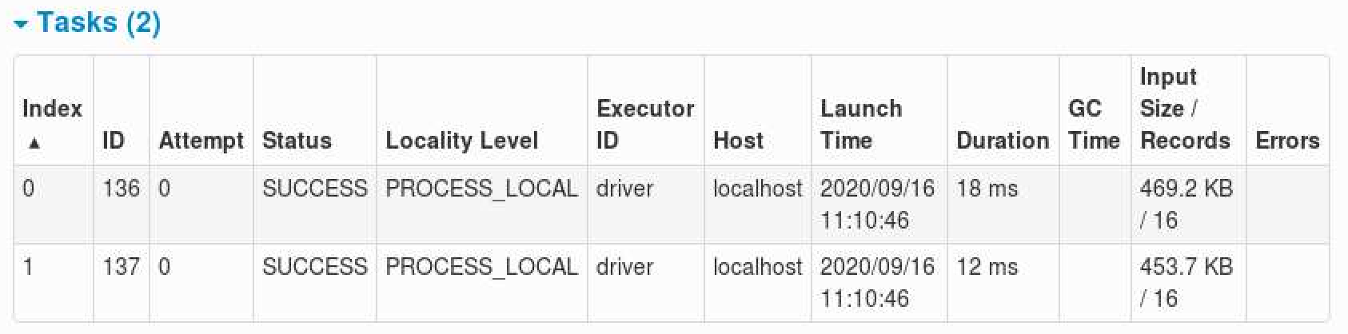
RDD in Spark and explore Web UI
Notes:
Tu je problem, ker CSV ni generiran ok in se pojavljajo napake pri branju,

Slide 53
RDD in Spark and explore Web UI
DAG exploration
def splitLine(line):
return line.replace(',', ' ').replace('"', ' ').replace('.', ' ').split()
rdd2 = sc.textFile('data/IMDB Dataset.csv', 4)
wordCounts = rdd2.flatMap(splitLine).map(lambda word: (word, 1)). \
reduceByKey(lambda a,b: a+b, 3)
wordCounts.takeOrdered(10, key = lambda x: -x[1])

Slide 54
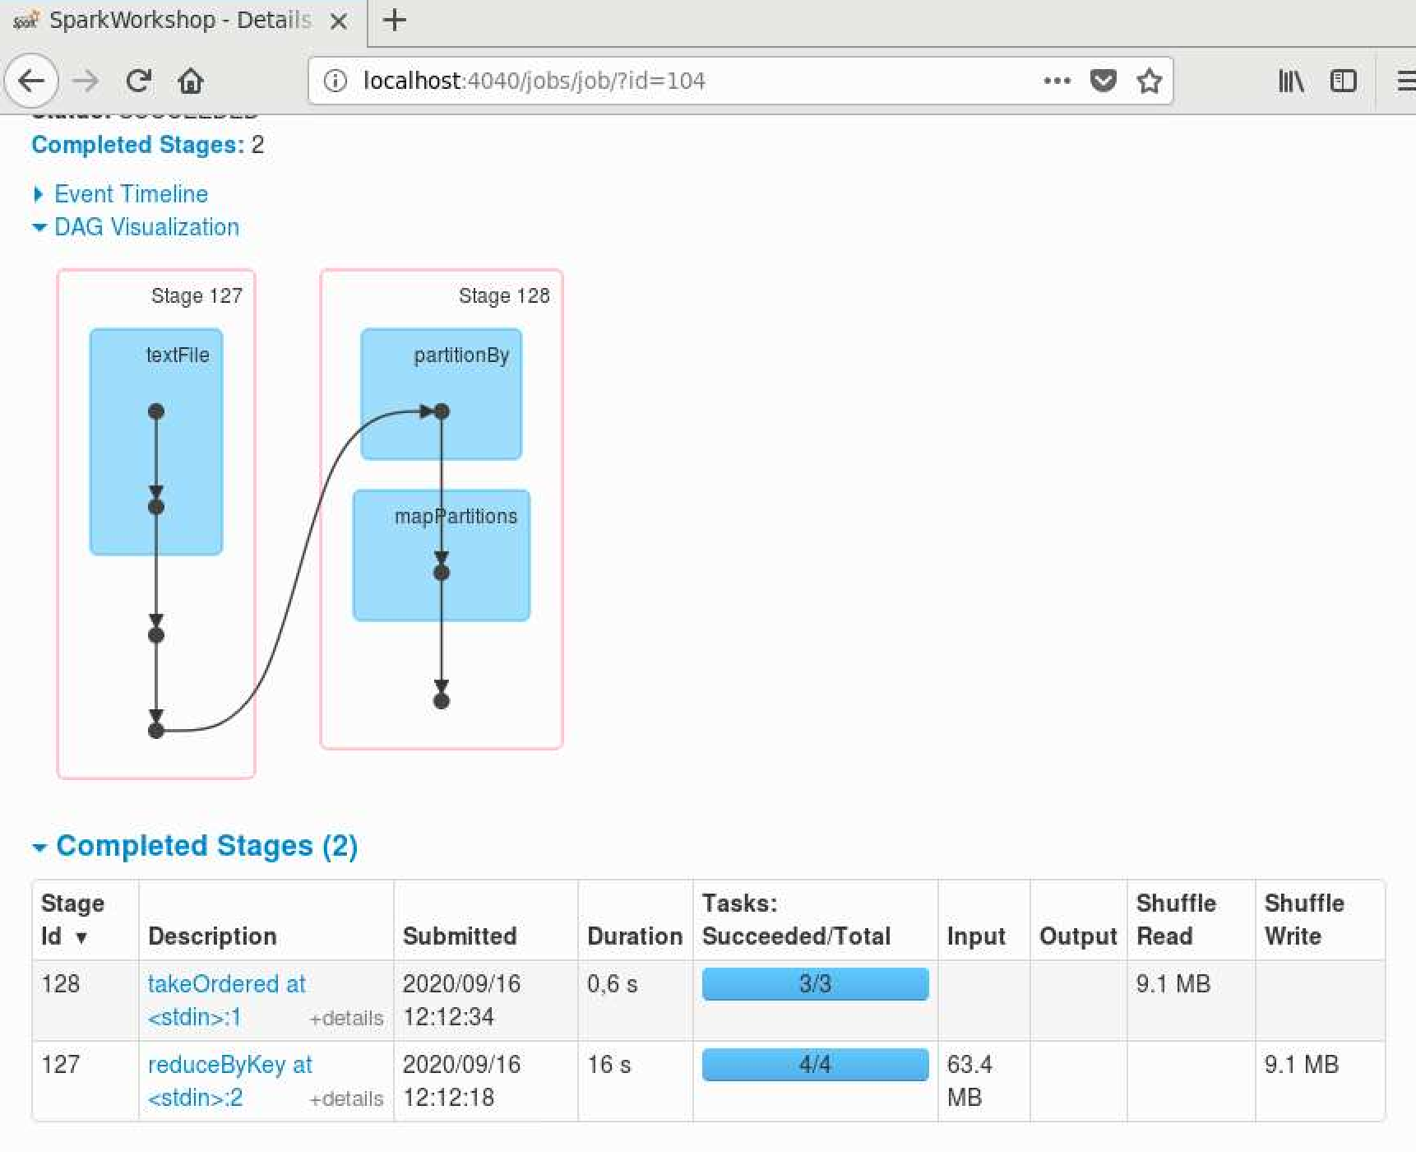
RDD in Spark and explore Web UI
DAG exploration (admin console result)
Notes:
Tu je problem, ker CSV ni generiran ok in se pojavljajo napake pri branju,

Slide 55
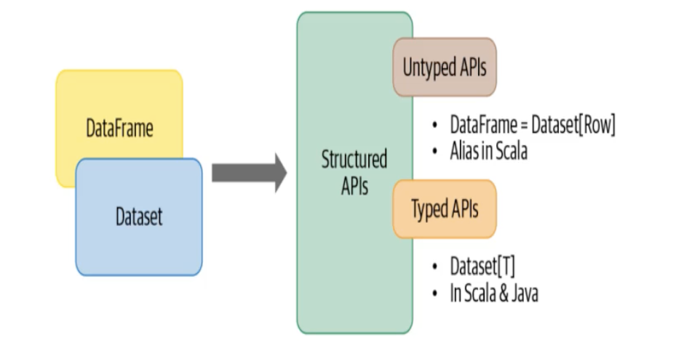
Structured API
Stuctured API – to address faster adoption and ease of use in comparison with RDD API

Slide 56
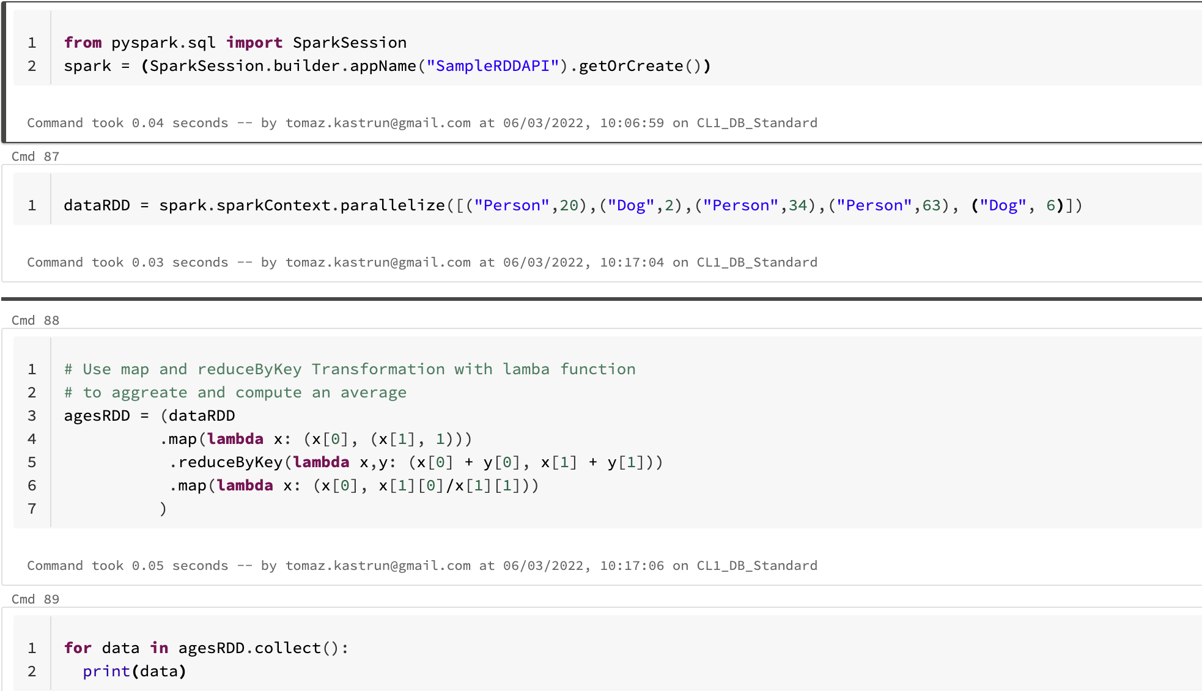
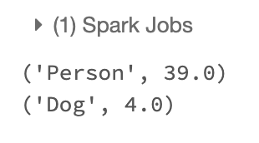
RDD API

Slide 57
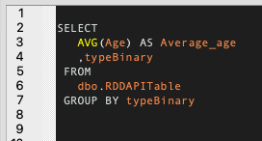
RDD API vs SQL

Slide 58
From RDD API to DataFrame and Dataset API
The dataset API is a collection of strongly typed JVM (Java Virtual Machine) data object in Scala and classes in Java
Typed:
Float avg_age = 23.4
avg_age = “SQLBits” // will return error
Untyped:
avg_age = 23.4
avg_age = “SQLBits” // will NOT(!) return error
The DataFrame is an Untyped API that has support for Python and Scala
Data Engineers prefere JAVA and Scala due to typed nature, because it provides better data integratity.

Slide 59
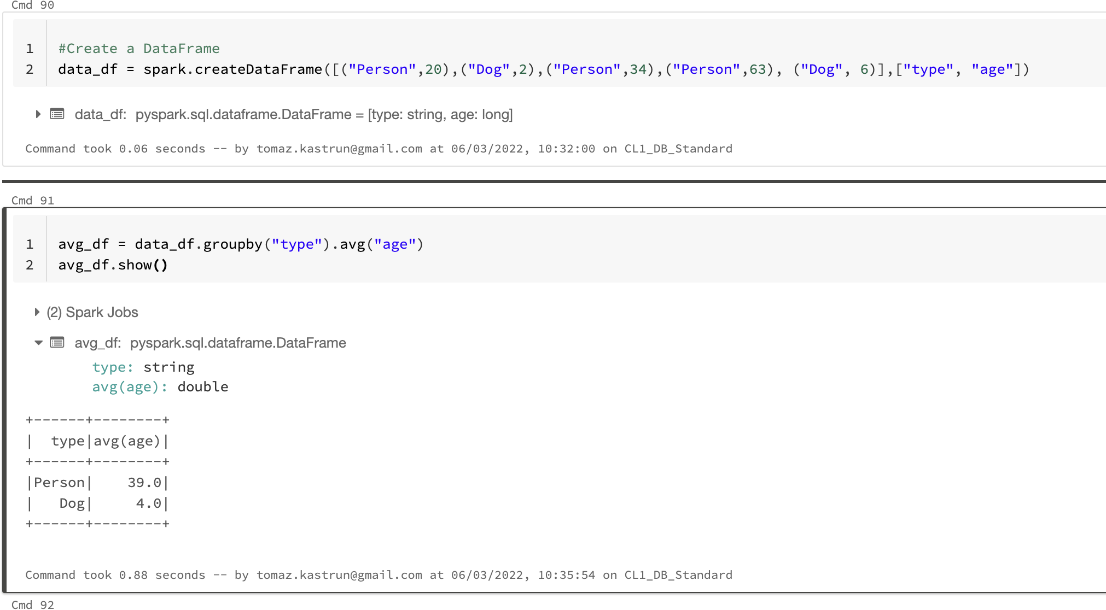
RDD API
DataFrame API

Slide 60
DataFrame API
The DataFrame accounts for readable „English“ like code which resembles SQL queries
The DataFrame allows you to have a structured presenttion of your data into rows and columns like database tables
The DataFrame allows you to assign schema to address potential the data integrity issues

Slide 61
Working with Spark API
Spark DataFrame API
Structured API (SQL)
Continue with Notebooks!

Slide 62
Module 2 – task 2
Create Schema (using PySpark or SparkR or Scala)
Import data (people.CSV)
Show dataframe
Create function to sum the age

Slide 63
Module 3
Designing and building pipelines, moving data and data models with Spark

Slide 64
Module 3
Data Pipelines and ETL/ELT
ETL Query
Data Source support
Schema inference
Data Quality
Transformation
Python for ETL and performance
Moving and copying data
Creating data models

Slide 65
What is pipeline
Data pipelines are set of instructions for data movement from source to sink. It is commonly known in data science community and also between data engineers for ETL or ELT.
Pipeline is understood as a:
sequence of transformations on data
Source data is typically semi-structured/unstructured (JSON, CSV etc.) and structured (JDBC, Parquet, ORC, the other Hive-serde tables)
Output data is integrated, structured and curated.
Data at the end of the pipeline is ready for further data processing, analysis and reporting.

Slide 66
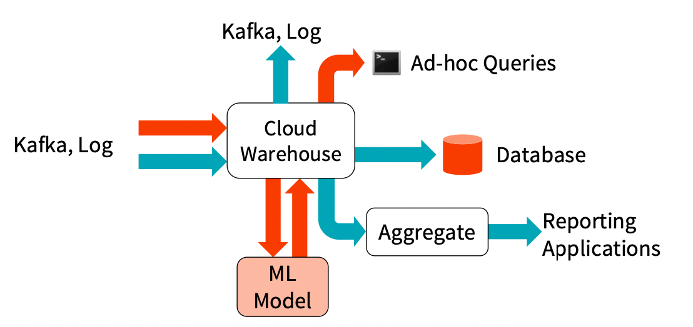
Daily scenario of data pipeline
Sequence of transformation on data
Source: semi-structured/unstructured (JSON, CSV etc.) and structured (JDBC, Parquet, ORC, the other Hive-serve tables)
Sink: Data is integrated, structured and curated and ready for consumption.

Slide 67
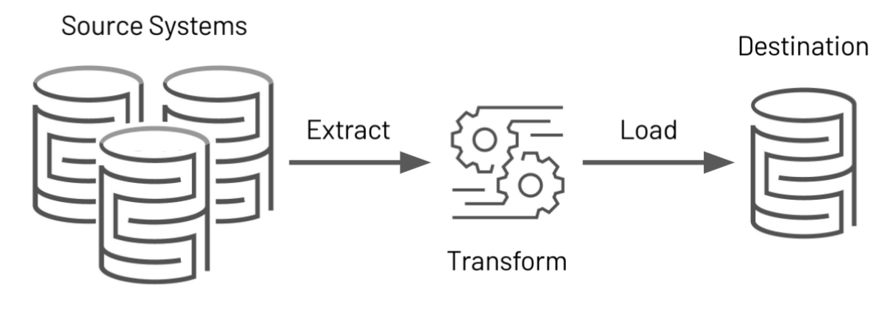
ETL is the first Step in a Data Pipeline
Goal: is to clean or curate the data.
Retrieve data from sources (EXTRACT)
Transform data into a consumable format (TRANSFORM)
Transmit data to downstream consumers (LOAD)

Slide 68
An ETL Query in Spark
spark.read.json("/source/path")
.filter(...)
.agg(...)
.write.mode("append")
.parquet("/output/path")
EXTRACT
TRANSFORM
LOAD

Slide 69
An ETL Query in Spark
val csvTable = spark.read.csv("/source/path")
val jdbcTable = spark.read.format("jdbc")
.option("url", "jdbc:postgresql:...")
.option("dbtable", "DBO. SALES")
.load()
csvTable .join(jdbcTable, Seq("shop_id"), "inner")
.filter("region_id <= 14") .write .mode("overwrite") .format("parquet") .saveAsTable("outputTableName")
EXTRACT
TRANSFORM
LOAD

Slide 70
Why is ETL process important!
Why is ETL process hard?
Matching different schemas
Matching different data types
Checking for data issues (corrupt files)
Checking for changes in schema
Scalability
Continuous ETL and ELT
Checking for data issues (corrupt files)

Slide 71
ETL must have and must be!
Error-prone
Fully Logged
ACID “in all aspects”
Always “fast” and never “too slow”
Cheap and low maintenance
Never ”too complex” and easy to “scale”
Fully documented

Slide 72
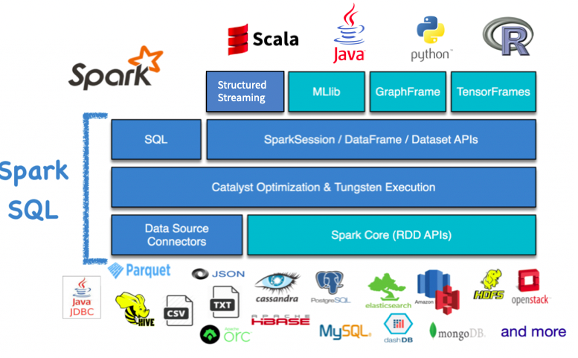
This is why ETL is important
Nobody wants messy and complex data ☺
Spark SQL's flexible APIs, support for a wide variety of datasources, build-in support for structured streaming, state of art catalyst optimizer and tungsten execution engine make it a great framework for building end-to-end ETL pipelines.

Slide 73
Data Source Supports
Built-in connectors in Spark:
– JSON, CSV, Text, Hive, Parquet, ORC, JDBC
Third-party data source connectors:
– https://spark-packages.org
Define your own data source connectors by Data Source APIs – Ref link: https://youtu.be/uxuLRiNoDio

Slide 74
Demos
Semistrctured data, JSON, CSV, FS, SQL– Part 2
Scala – Part 3
3)

Slide 75
Module 3 - Task 3
Explore and run Notebook:
Py3-Module3-Dataframes with Python

Slide 76
Module 4
Architecture concepts, Data and process orchestration

Slide 77
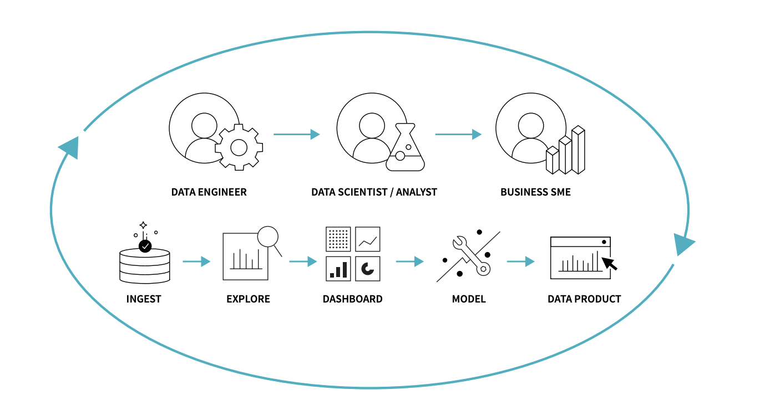
Data and processes
DATA INGESTION AND EXPLORATION
TRAINING THE MODEL
DEPLOY TO PRODUCTION

Slide 78
Storage patterns
Data Warehouse
Data Lake
Data Lakehouse

Slide 79
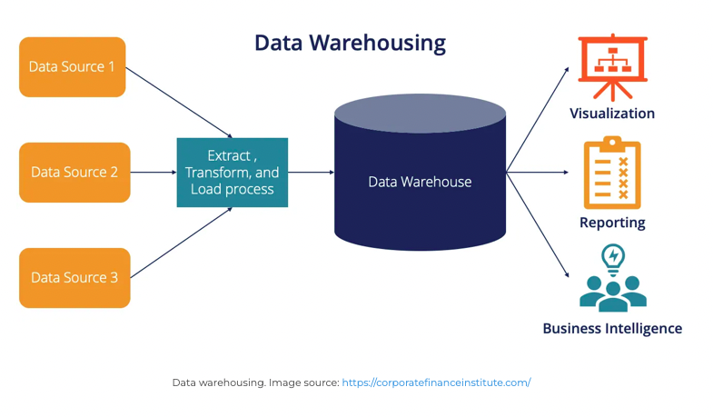
Data warehouse
Unified data repository for storing large amounts of information from multiple sources
Combines relational datasets from business apps, ERP, CRM, FICO
Transactional data and master data
Processes: extracting, cleaning, matching, transforming, storing, versioning, consuming

Slide 80
Data Warehouse PRO
Data Warehouse CON
Data canonization / standardization
Improved data quality, consistency
Improves decision-making business process and analytics
Lack of flexibility
“Struggles” with semi- and un-structured data
High OPEX (implementation, CI/CD, maintenance)

Slide 81
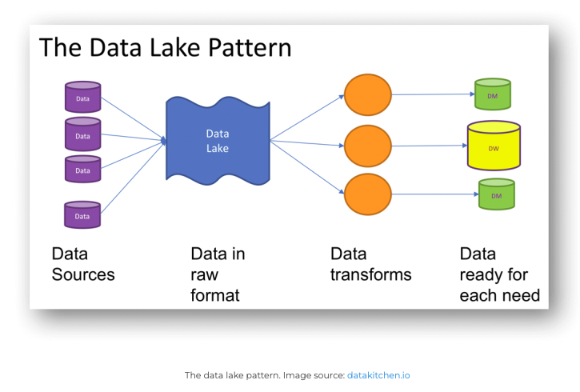
Data Lake
Centralized and highly flexible storage repository
For structured, unstructured data; original / raw format
Durable, cost-effective
Schema on-read
ETL for purposes and “ad-hoc”
Machine learning, Shallow/Deep
IoT devices, streaming data

Slide 82
Data Lake PRO
Data Lake CON
Data consolidation (structured + unstructured)
Improved flexibility
Cost savings (object store)
Improvedd and support for variety analytics, shallow and deep learning (machine learning)
Lack of management
Enforcing data reliability
Uniform security model (data formats)

Slide 83
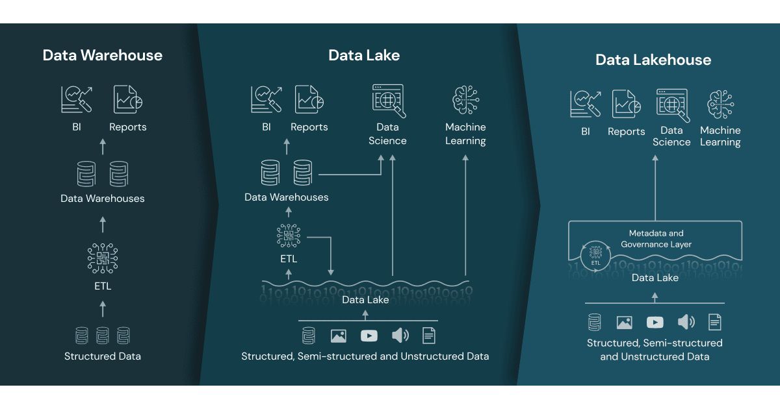
Data Lakehouse
Scalable data lakes
Organized data management
Organized ACID for:
Transactional data (DWH)
Improved analytics (DWH)
Improving ML, DL (DWH, Data Lake)
Metadata layer for data lakes
Improved Query engine
Optimized acces for data science

Slide 84
Notes:
Metadata layers, like the open source Delta Lake, sit on top of open file formats (e.g. Parquet files) and track which files are part of different table versions to offer rich management features like ACID-compliant transactions. The metadata layers enable other features common in data lakehouses, like support for streaming I/O (eliminating the need for message buses like Kafka), time travel to old table versions, schema enforcement and evolution, as well as data validation. Performance is key for data lakehouses to become the predominant data architecture used by businesses today as it's one of the key reasons that data warehouses exist in the two-tier architecture. While data lakes using low-cost object stores have been slow to access in the past, new query engine designs enable high-performance SQL analysis. These optimizations include caching hot data in RAM/SSDs (possibly transcoded into more efficient formats), data layout optimizations to cluster co-accessed data, auxiliary data structures like statistics and indexes, and vectorized execution on modern CPUs. Combining these technologies together enables data lakehouses to achieve performance on large datasets that rivals popular data warehouses, based on TPC-DS benchmarks. The open data formats used by data lakehouses (like Parquet), make it very easy for data scientists and machine learning engineers to access the data in the lakehouse. They can use tools popular in the DS/ML ecosystem like pandas, TensorFlow, PyTorch and others that can already access sources like Parquet and ORC. Spark DataFrames even provide declarative interfaces for these open formats which enable further I/O optimization. The other features of a data lakehouse, like audit history and time travel, also help with improving reproducibility in machine learning. To learn more about the technology advances underpinning the move to the data lakehouse, see the CIDR paper Lakehouse: A New Generation of Open Platforms that Unify Data Warehousing and Advanced Analytics and another academic paper Delta Lake: High-Performance ACID Table Storage over Cloud Object Stores.

Slide 85
Data lakehouse PRO
Data lakehouse CON
Reduced data reduncency
Improved flexibility
Cost effectiveness (combination of DWH and Data Lake)
Improved data governance, data management, and security
Support for variety of workloads (analytics, open data formats (API, parquet))
Straightforward Machine Learnign
Relatively new (concept)
Improved, yet immature technology
Offerings (Databricks)

Slide 86
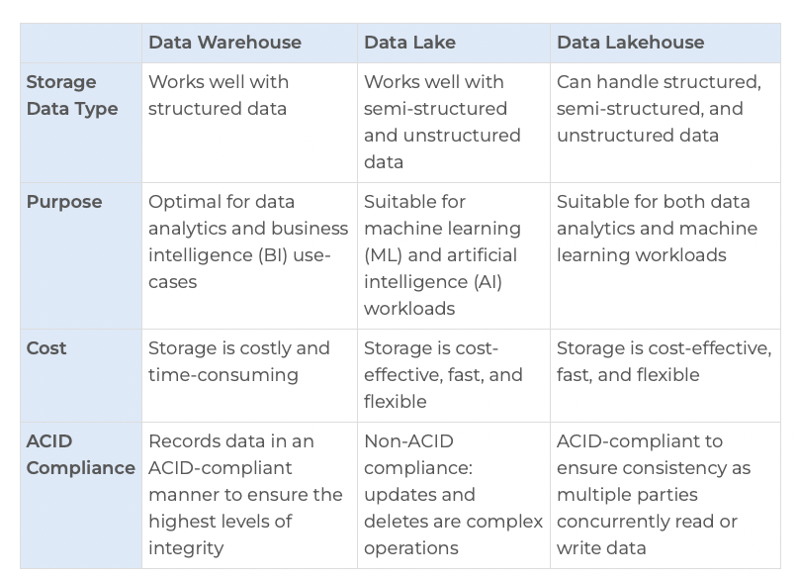
Recap: DWH vs. DL vs. DLH

Slide 87
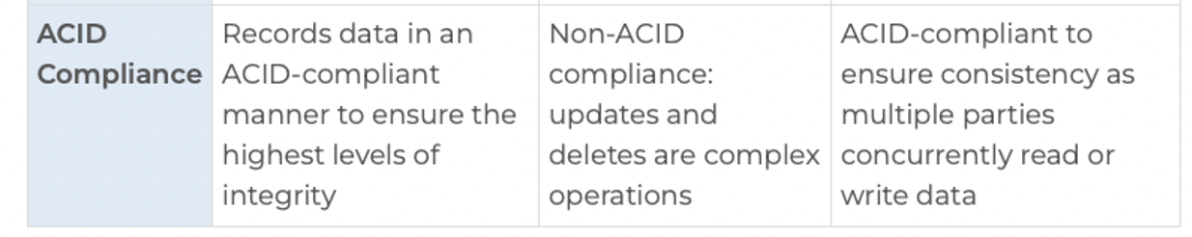
Achieving ACID in Spark
ACID – Atomicity, Consistency, Isolation, Durability
Providing data in data lake to be consistent and durable
Spark Hive tables
Delta lake (Databricks)
HUDI (Hadoop Upsert Delete and Incremental) by Uber/Apache

Slide 88

ACID limitations on Hive
Hive tables should be created with TRANSACTIONAL table property.
Hive supports ACID transactions on tables that store ORC file format.
Enable ACID support by setting transaction manager to DbTxnManager
Annoyances:
Transaction tables cannot be accessed from the non-ACID Transaction Manager (DummyTxnManager) session.
External tables cannot be created to support ACID since the changes on external tables are beyond Hive control.
LOAD is not supported on ACID transactional Tables. hence use INSERT INTO.

Slide 89
ACID on Data Lake (files)
ETL frameworks / ELT pipelines
Assuring zones (architecture)
Logging, storing, updating
Delta Lake (Databricks)

Slide 90
File Types in supported in Spark
.CSV – delimited text file using comma, semicolon to separate values.
.TXT – delimited text file.
.JSON – text file that stores simple data structures and objects. Standard for data interchange
.Parquet – column storage file format used by hadoop systes, such as Pig, Spark, and Hive. It has binary presentation, is cross platform.
.AVRO – open source data serialization system by Apache Hadoop. stores serialized data in binary format and schema in JSON format.
.ORC – open source columnar data storage format. Similar to Parquet. Is cross platform
… and others
ORC – created by HortonWorks (feb 2013)
Apache Parquet – Created by Cloudera and twitter (may 2013)

Slide 91

Avro vs. Parquet vs. ORC

Slide 92

Organizing data Lake layers
Data Lake is a “single” repository
Separating them into layers
Architecture of layers / zones
Each layer represents additional data manipulation
Layers:
Raw
Standardized
Cleaned
Application
Sandbox
Alternatives:
Raw > Curated > Enriched
Sandbox, Machine Learning
Ingest > Curated > Conformed > Production
Sandbox, Personal, Reporting, Machine Learning
Bronze > Silver > Gold
Sanbox, Work, Machine Learning

Slide 93
Organizing data Lake folders
Folder structure within Layer
Folder by purpose:
Area
Source
Object
>>Key<<
Raw data
Folders by structure
Purpose
Files
Type

Slide 94
Organizing data Lake - Keys
Keys are considered as “index”
Keys help data organized
Implement keys based on search
Folder structure:
Year=2022
Year=2022&Month=03
GeoAreaID=100&Year=2022

Slide 95


Files organization
Raw Layer
Sales
CustomerOrders
Year
Month
Raw_Sales_CustomerOrders_2022_03_01.csv
Raw_Sales_CustomerOrders_2022_03_05.csv
CustomerInvoices
Year
Month
Raw_Sales_CustomerInvoices_2022_03_01.csv

Slide 96
Structure, type, access, granulation
Granulation (e.g.: strem data)
As is
Aggregate to higher level (e.g. from sec -> min)
Another abstration layer above (e.g.: from sec -> hour)
Higher granulation (e.g. Day, month, custom)
Folder structure
Raw layer
Standardized layer
Cleaned layer
Application layer
Data Types
Original format
Files aggregated, still original format
Sparsed (faster) format
Custom to application
Access control
Data Engineers
Data Engineers, Data Scientists
Data Engineers, Data Scientists, Data Analysts
Data Engineers, Business people, Data Analysts

Slide 97

Data Lake Architecture
Data Lake architecture of layers

Slide 98
Data Lake Components
Security
Governance
Metadata
Stewardship
Master data
Archiving
Orchestration

Slide 99
Architecture designs
Architecture designs can be influenced by:
Data load patterns (hot/cold, real-time, stream, increment/full)
Time partitioning
Data type (relational, time series, blob)
Subject areas and sources
Security and roles
Retention policies (temporary, permanent, time-fixed)
Business impact (Core, Critical, High, Medium, Low)
SLA and regional regulations
GDPR and confidential classifications (public use, internal use, financial, Government, supplier/partner confidential)

Slide 100

Parquet: Table partitioning
Parqueta is a columnar format
Spark SQL API provides support for reading and writing Parquet file
Parquet preserves the schema of the original data.
When readin, all columns are automatically converted to be nullable for compatibility reasons.
Partition discovery is optimization support

Slide 101
Working with Parquet files (Spark + Python)
Appending
Overwriting
Compling
Caching
Reading / writing
Continue with Notebooks

Slide 102
Moving data around using fs / dbutils and DBFS API 2.0
Python:
import os
os.listdir('/dbfs/tmp')
dbutils.fs.ls("/mnt/mymount")
df = spark.read.text("dbfs:/mymount/my_file.txt")
Bash
%fs ls /tmp/
%fs mkdirs /tmp/my_cloud_dir
%fs cp /tmp/test_dbfs.txt /tmp/file_b.txt

Slide 103
Moving data around using CLI / PS / Spark SQL CLI
CLI:
mkdirs /tmp/my_cloud_dir
cp /tmp/test_dbfs.txt /tmp/file_b.txt
PS
Spark SQL CLI
./bin/spark-sql

Slide 104
Exception handling and exception coding

Slide 105
Logging and working with logs

Slide 106


Delta lake
Open source data storage layer that unifies ACID transactions, scalable metadata management and batch and/or streaming data processing. It also offers time travel and CDC, SCD, streaming upsers operations
Sits on top of your existing Data Lake in tandem with Apache Spark APIs.

Slide 107


Delta Live tables (Databricks)
DLT helps data engineers to build and manage reliable data pipelines for better data quality.
DLT simplifies ETL development and management with declarative pipeline development, automatic data testing and improved visibility for monitoring and troubleshooting

Slide 108
Demos
Py4 – Module 4 (working with Parquet files)
Py4-Module4-Diving Into Delta Lake

Slide 109
Module 4 - Task
Complete notebook:
Py4 - Module4 - Task

Slide 110
Module 5
Spark Streaming

Slide 111

Spark Streaming
Spark Streaming or Structured Streaming is a scalable and fault-tolerant, end-to-end stream processing engine.
Extention of the core Spark API.
Data can be processes from many sources (Kafka, Fume, Kinesis, Twitter, TCP Sockets,…)
Data can be pushed out to filesystem, databases, dashboards

Slide 112

How it works:
Spark Streaming receives live input data streams and divides the data into batches
Batches are then processed by the Spark engine to generate the final stream of results in batches.

Slide 113
DStreams
Discretized Stream or Dstream is represented as contionus stream of data.
It can be Kafka, Kinesis or high-level operations
Dstream is internally represented as a sequence of RDDs
Supports Java, Scala, Python, also R. (both Py and R with some limitations)

Slide 114

DStreams

Slide 115
Dstreams to RDD
Each batch of Dstream is represented as RDD underneath
RDD files are replicated in cluster for fault tolerance
Every Dstream operation results in RDD Transformation
API access is available
Dstream can be stream and batch processing

Slide 116

Dstream transformation

Slide 117

Socket example with file stream
File stream allows to track new files in a given directory (on HDFS)
When new file appears, Spark Stream will pick it up
It will pick only new files, modification of existing files will not be considered
Tracks using file
creation time

Slide 118

Auto Loader
Incrementally processes new data files that arrive in storage
Structured streaming source is called cloudFiles
Any new files that arrive in storage are automatically processed
It uses COPY INTO command

Slide 119
Benefits of Auto Loader over Apache Spark
Apache Spark can read files incrementally using spark.readStream.format(fileFormat).load(directory).
Auto Loader provides benefits:
Scalable; can discover billion of files efficiently and backfills are performed asynchronously to avoid wasting compute resources
Performance; discovering files with AL scales with the number of files that are being ingested instead of number of directories that the files may land in
Schema inference; automatically detects schema drifts and nofity you
Cost; native cloud API to get to existing storage. File notification mode help reduce cloud costs by avoiding directory listing altogether

Slide 120
Demos
Py5 -Module5
Py5-Moodule5-Delta Live Tables quickstart (Python) (Databricks only)
Delta Live Tables quickstart (SQL)

Slide 121
Module 5 – Task
Run the code / read Task:
Task5-Using-TCP-spark-streaming.md

Slide 122
Check VM
Username: tomazkastrun
Pass: TomazKastrun.2022

Slide 123
Module 6
Comparison Scala Python, Full scale demo, Recommendations, Troubleshooting

Slide 124

Optimization recommendations for Spark jobs
1 Use Apache Parquet file format
Achieves great performance when performing queries (transformations) on a subset of columns and on a large dataframe. This is because it loads only the data associated with the required columns into memory.
Parquet also improves reading / writing of the binary files in data lake, because it has compressed schema and encoding for each column.

Slide 125

Optimization recommendations for Spark jobs
2 Maximize parallelism in Spark
The more we facilitate the division into tasks, faster they will be completed and therefore optimizing means, reading and processing as much data as possible in parallel. So, splitting a dataset into several partitions.
Set paramter spark.sql.files.maxPartitionBytes in accordance with your HDFS I/O system. Default is 128MB but it can be set to smaller value

Slide 126

Optimization recommendations for Spark jobs
3 Use Broadcast Hash Join (BHJ)
Joining dataset is a common operation. In distributed context, network latency can cause slow query processing. Spark SQL offers many, BHJ is suitable when one of the merged dataframe is small to be duplicated in memory on all executing nodes (broadcast operation)
By duplicating smaller dataframes, the join no longer requires significant data exchange in the cluster, apart from the broadcast of this table.
Set parameter: spark.sql.autoBroadcastHashJoin

Slide 127

Optimization recommendations for Spark jobs
4 Cache intermediate results!!!
Caching is performed when spark action is run.
Spark uses lazy evaluation and DAG to describe the job how RDD concept is set. This offers possibility to quickly recalculate the step before an action is necessary! To take full advantage of this feature, is it wise to store expensive intermediate results, when several operations follow this operation in downstream of DAG.
When caching, the result is stored
On disk and/or memory.

Slide 128
Optimization recommendations for Spark jobs
5 Beware of UDF in non-native Scala
Spark API, especially Python, R and SQL can have problems converting user defined functions to native Java.
Check for user create functions and use functions on Spark core to achieve better performance.

Slide 129
Optimization recommendations for Spark jobs
6 Manage the memory of the executor nodes
By default spark.memory.fraction is set to 0.6; meaning 60% of the memory is allocated for execution and 40% for the storage, once the reserved memory is removed. Beware of out of memory (OOM) errors.
this can be modifies using two parameters:
spark.executor.memory
spark.memory.fraction

Slide 130
Optimization recommendations for Spark jobs
7 Easy on shuffle operations
When a wide transformation is created (e.g.: groupBy(), join()), where will be shuffle partition created that can cause network traffic and read/write disk resources.
Parameter: spark.sql.shuffle.partitions with default 200 partition which can be too high for some operations. Adjust this parameter to size of data (smaller datasets, smaller number) and to number of CPU cores per cluster (partitions <= number of CPU cores). SSD disks improve this issue significantly.

Slide 131
Documentation, learning
ApacheCon conference (ApacheCon | Home)
Apache Flink conference
Airflow summit
Spark + AI Summit
Data + AI Summit (Databricks conference)
Books:
O’Reilly
Packt Publishing
HB publishing
Community:
Stackoverflow
Meetup: Spark, Hadoop, IBM

Slide 132
Tools and providers for Apache Spark
Complete apache Family
Cloud providers: Azure, AWS, GC, Oracle
ETL, ELT tools

Slide 133
Demo
Module 6 – Performance Scala vs. Python
Py6-Module6 Story with MLlib

Slide 134
Thank you for attending
Feel free to connect, or if you have any inquiries, questions, need help…

